Slide 1

Internet Safety Tips
(www.buddiesforseniors.org)

Slide 2
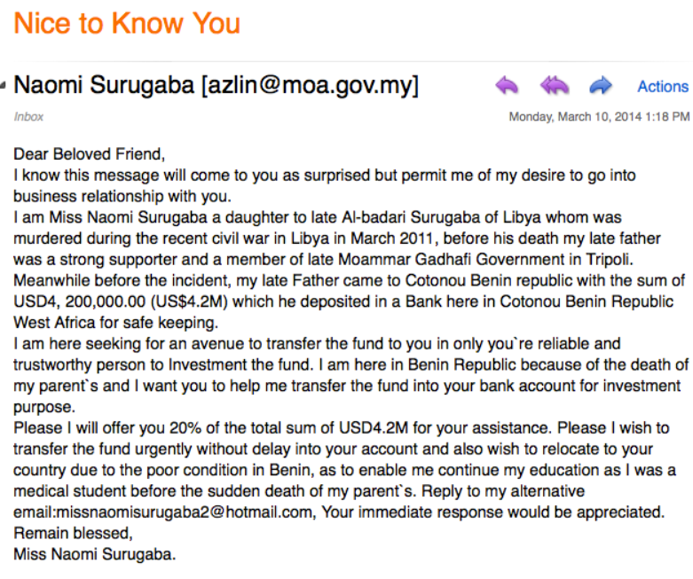
Nigerian Email scams (Don’t fall for fortune from strangers)
No one is giving away Millions from Nigeria
Notice the grammar and spelling errors
How did they find us to give the money?
Victims lost Millions of Dollars in Nigerian online scams

Slide 3
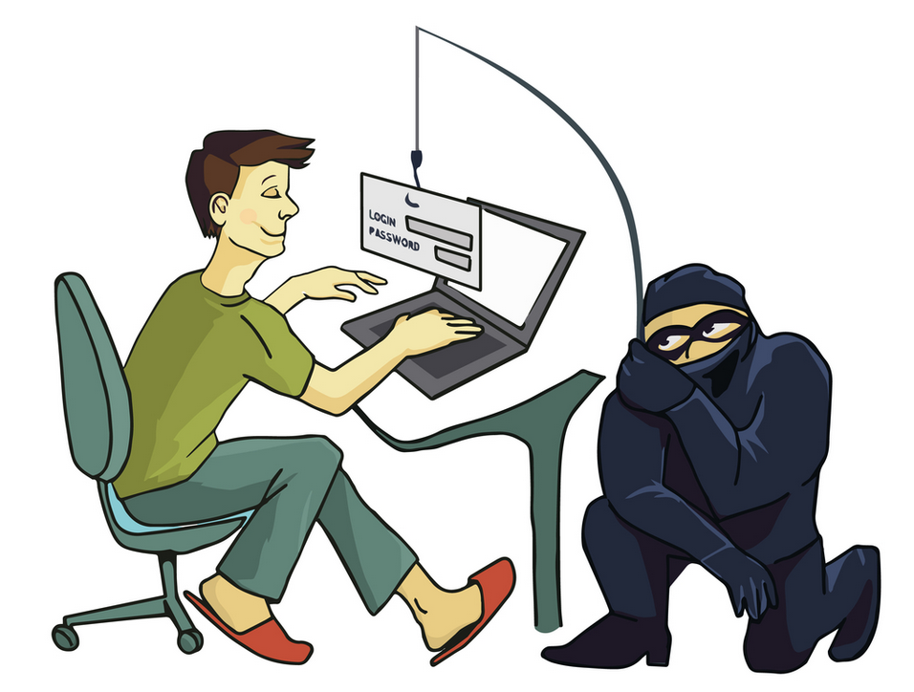
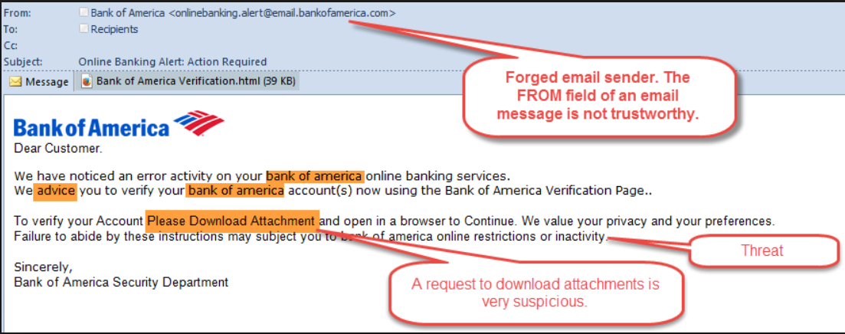
Phishing scams for Banks (Look before you click)
Scammers want to get your personal details
Look out for suspicious mails (web address, threats, suspicious asks)

Slide 4
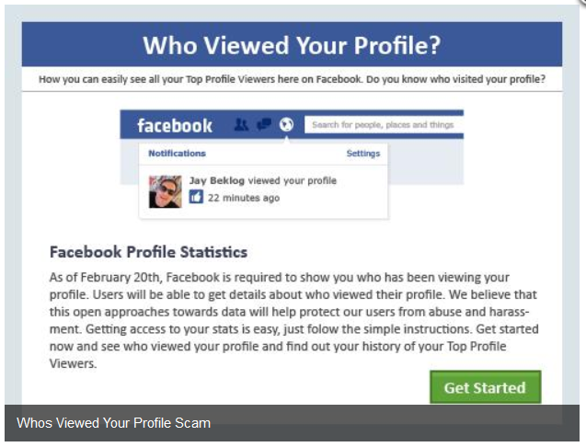
Facebook scams (Don’t install apps that you don’t know about)
Know people before you accept friends
(Look at their profile, friends, activity to confirm)
Don’t trust chain give away of stuff on FB
Don’t install apps/plugins that you don’t know about

Slide 5
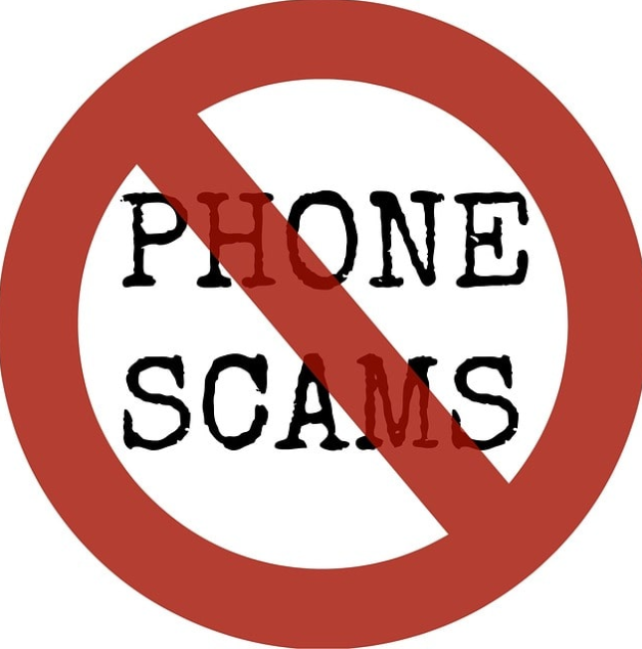
Phone scams (No, IRS does not threaten you over phone)
Internal Revenue Service does not ask for
money over phone
IRS does not threaten with arrest over phone
IRS sends information in regular post/mail

Slide 6

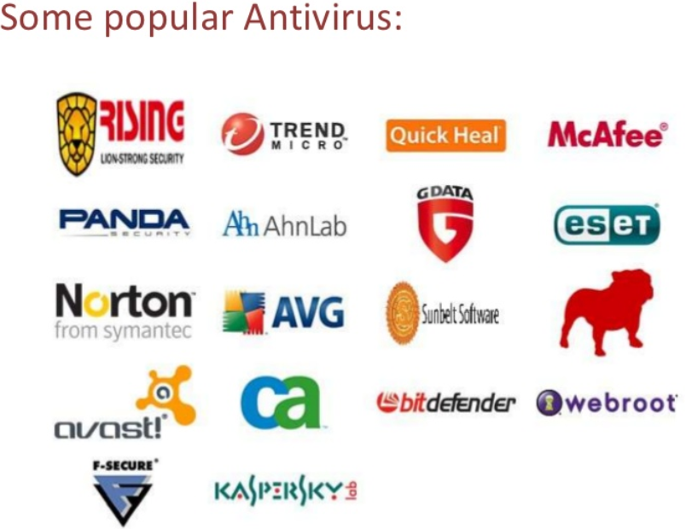
Keep Antivirus program up to date …
Antivirus protects against all kinds of malicious attacks
(viruses, malware, trojans, botnets, ransomware, rootkits.. Oh my)

